Slide 1
Towards Foundation Models for Solving Corner Cases in Autonomous Driving
Chufeng Tang
Intelligent Automotive Solution BU, Huawei
Notes:
*Hello everyone. I’m Chufeng Tang, comes from Huawei, and I work for building intelligent automotive solution for vehicles.
*Today I‘m honored to have the opportunity to be here to share with you our thoughts on foundation models for solving corner cases in autonomous driving.

Slide 2


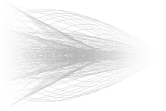
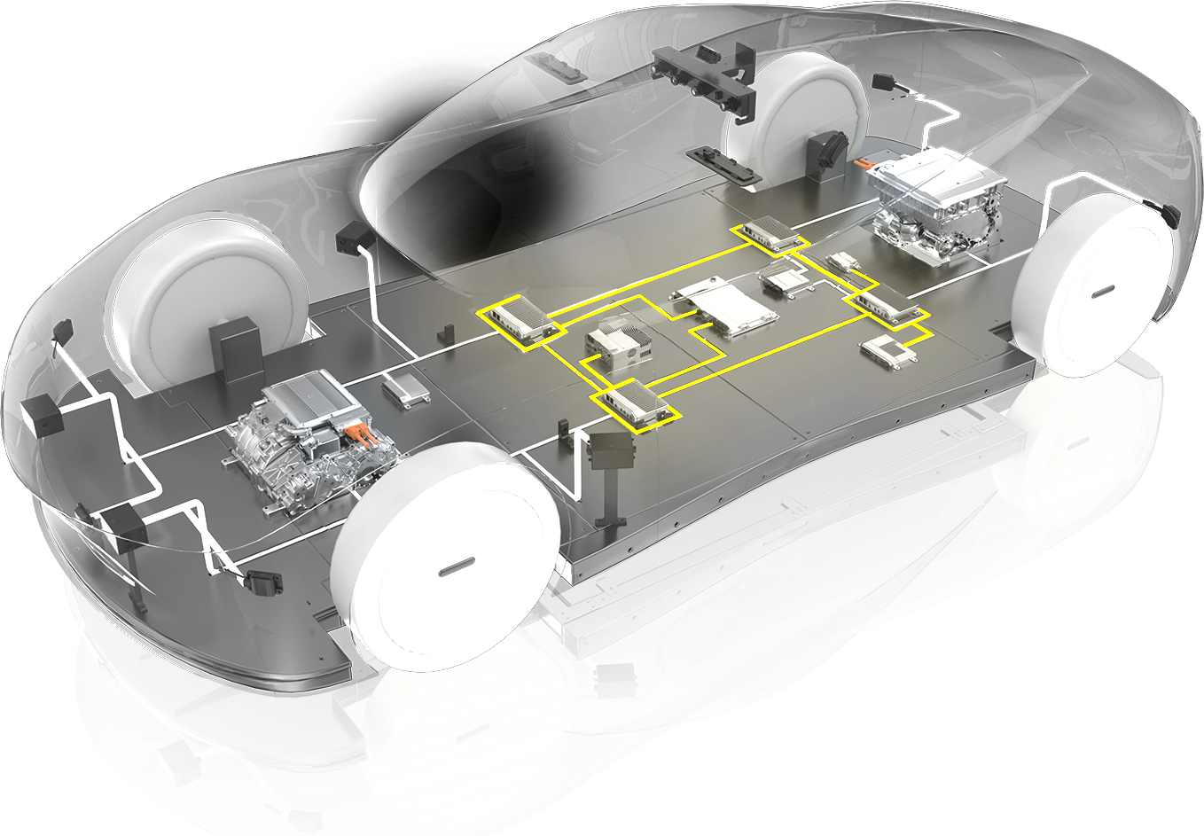
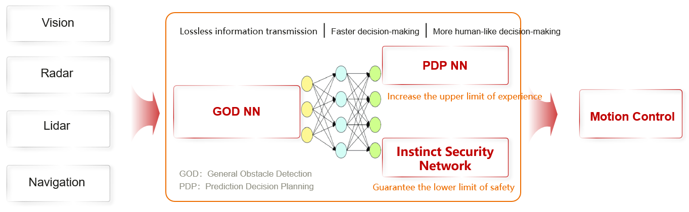
About Us
Huawei IAS: working with partners to empower intelligent development of the automotive industry
Intelligent Vehicle Cloud Services
Intelligent Connectivity
Intelligent Cockpit
Intelligent Driving
Intelligent Automotive Optics
Intelligent Vehicle Control
Intelligent Electrification
Focusing on ICT, Huawei helps OEMs build better vehicles.
Digital Power | HarmonyOS | Computing | Wireless Communications | Optical Technology | Huawei Cloud
Notes:
*First is a short page introducing Huawei intelligent automotive solution business unit, our mission is working with partners to empower intelligent development of the automotive industry.
We have a broad scope of business, including … and so on.
*For autonomous driving, we have recently launched a new architecture of advanced driving system, which achieves
smoother and more human-like driving in complex road conditions.
And we also achieving a leading position in the Chinese market.

Slide 3
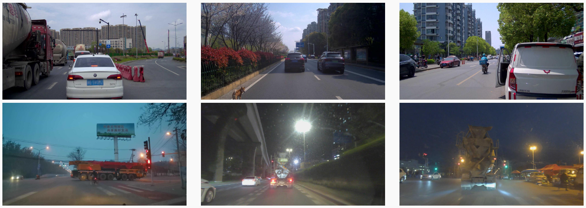
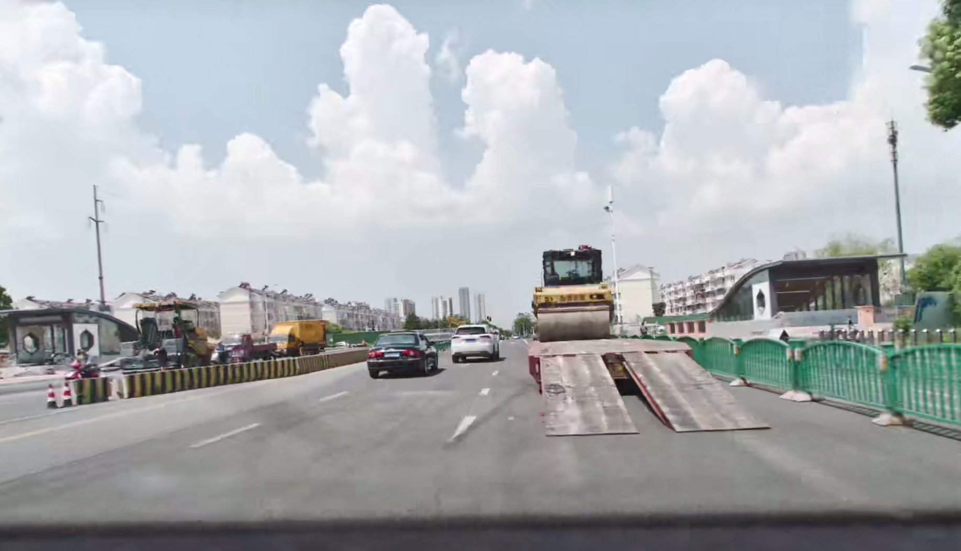
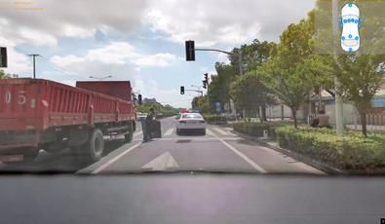
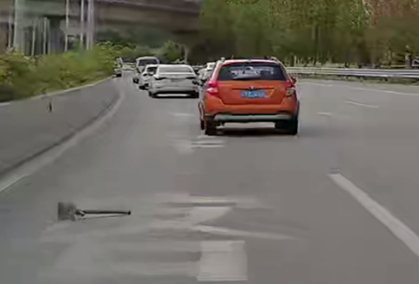
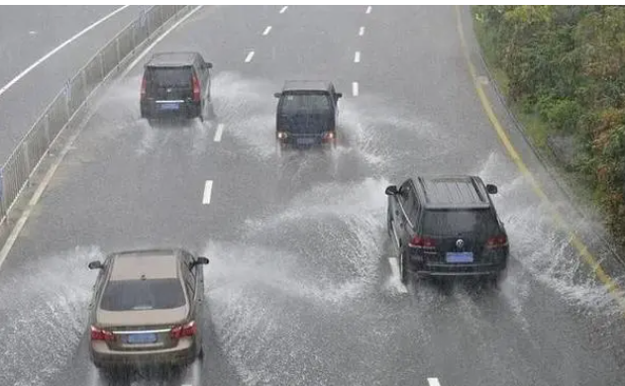
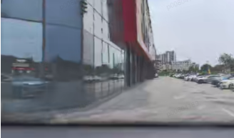
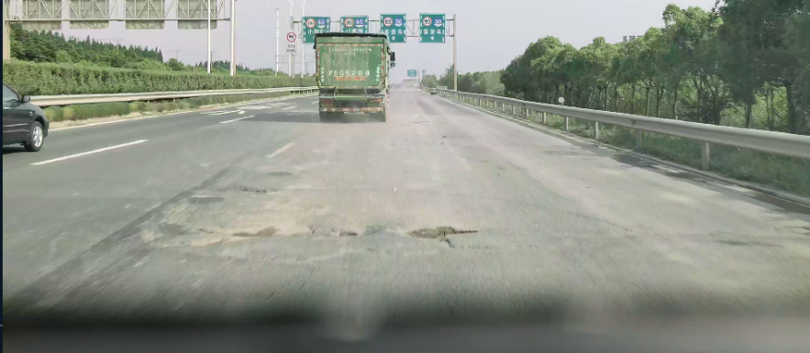
CODA: A Real-World Road Corner Case Dataset for Autonomous Driving. Li et al., ECCV 2022.
Corner Cases in Autonomous Driving
CODA (mostly perception-orientated) and beyond.
Notes:
*Today, this workshop is about corner cases in autonomous driving.
*As an intelligent driving solution provider, we have over 4 hundred thousand autonomous vehicles running on the road.
There are a lot of really challenging corner cases, some of which are more difficult than the released CODA dataset, which is mostly perception-orientated.

Slide 4
Solving Corner Cases with Foundation Models
Existing paradigm: collect corner cases -> annotate -> re-train
Challenges: 1) collecting & labeling cost, 2) data balancing, 3) hard to exhaust, etc.
Abilities we need for solving corner cases: open-world perception, complex reasoning, etc.
Solving corner cases with two types of foundation models:
Vision-Language Model
World Model
1. corner case understanding
2. corner case generation
Main topics of this workshop/challenge
Notes:
*In the traditional paradigm, we usually handle corner cases by means of collecting-annotating-and re-training. However, this approach faces a number of challenges such as the collection and labeling cost, data balancing problem during training, and more importantly it’s impossible to exhaust all corner cases.
*Based on these challenges, we need to come up with new paradigms for solving driving corner cases, which should have abilities of open-world perception, complex reasoning, and so on.
*Now, the most promising solutions look to be foundation models. Today, I'm going to focus on two types of foundation models, vision-language models and world models, which correspond to the main topics of this workshop: corner case understanding and generation.
*I will share some of our thoughts in these directions, and point out some challenges we see in practice.
It is hoped to discuss with the community of computer vision and even seek out some possible collaboration opportunities.

Slide 5
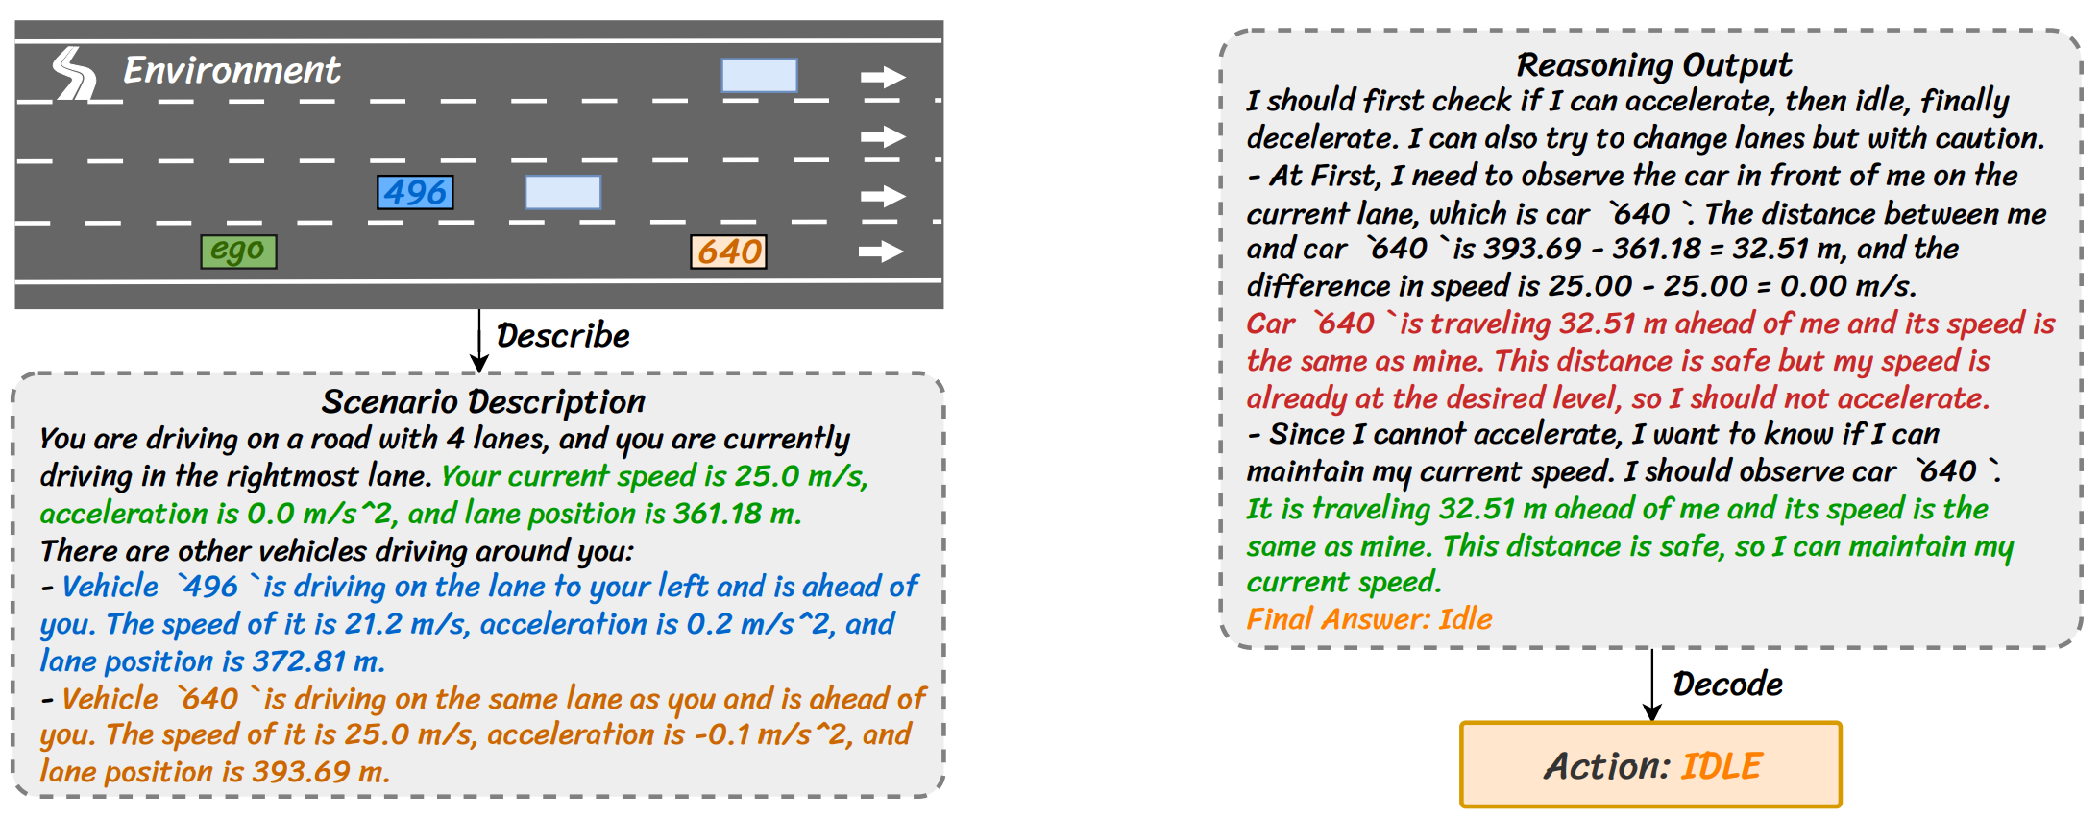
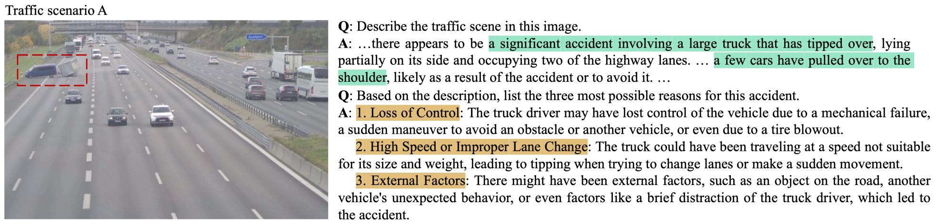
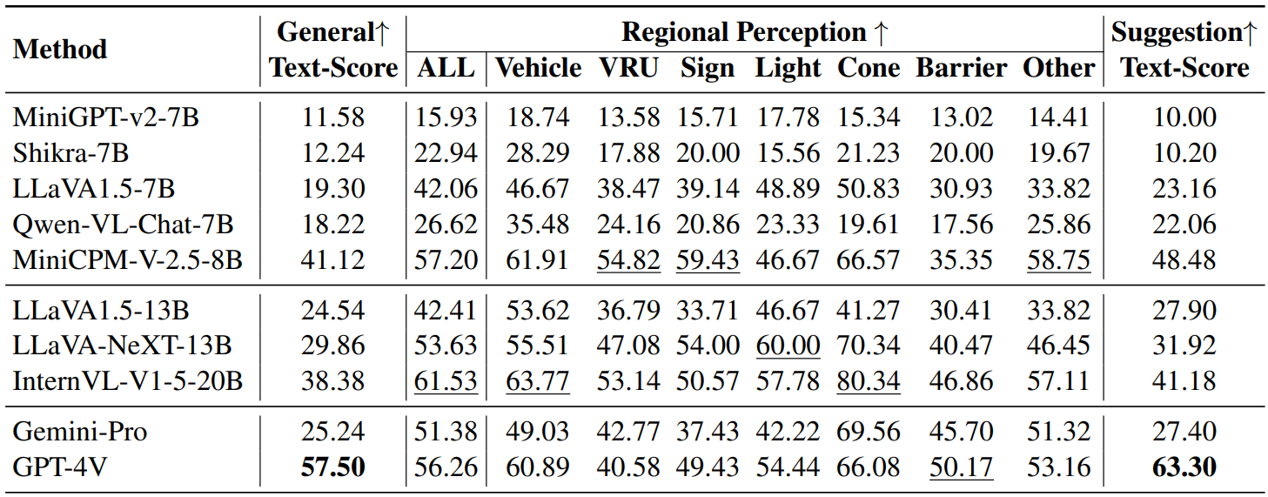
Automated Evaluation of Large Vision-Language Models on Self-driving Corner Cases. Chen et al., arXiv 2024.
On the Road with GPT-4V(ision): Early Explorations of Visual-Language Model. Wen et al., arXiv2023.
Drive as You Speak: Enabling Human-Like Interaction with Large Language Models. Cui et al., WACVW 2024.
Vision-Language Models for Autonomous Driving
Pretrained VLMs are able to handle sorts of driving scenarios,
but still suffer from the complicated road corner cases.
Testing different LVLMs on CODA-LM
Notes:
*First one is the vision-language model.
According to the testing of some previous works, the pre-trained vision-language model (I mean it has not been fine-tuned with driving data), already has preliminary ability to handle some corner cases. For example, GPT4Vision successfully recognized the accident ahead in this picture and gave meaningful driving advice.
*However, a recent research work tested the performance of several pre-trained large models on the CODA-LM dataset, which collects question-answering annotations for corner cases in CODA. Some of the models, even recognized to be excellent in general-purpose question-answering, still have unsatisfactory abilities in regional perception of driving scenarios.

Slide 6
Vision-Language Models for Autonomous Driving
Three types of application:
VLM
Vision
PnC
VLM
Sensors
&
Prompts
Answer
in
Texts
Sensors
&
Prompts
Sensors
&
Prompts
Action
or
Ego Traj.
VLM
1. VLM as Scene Descriptor
2. VLM co-work with Planner
3. VLM for E2E Driving
Cloud inference
Perception/reasoning QAs
On-board inference
Asynchronous
On-board inference
Real-time
Notes:
*Over the past year, a series of research efforts have looked to enhance the capabilities of the vision-language models by fine-tuning with driving-domain data. We roughly divide these works into three groups, from the perspective of applying vision-language models to solve real-world driving corner cases.
*First, vision-language model as scene descriptor, which adapts general-purpose models into the driving domain to perform perception or reasoning question-answering.
*Second. vision-language model co-works with the planner. There are two systems executed asynchronously, where a real-time model for trajectory planning, and a low-frequency vision-language model handling harder cases.
*Third, adopting vision-language model for end-to-end driving, is an unified solution, where the vision-language model takes multi-sensor inputs and directly outputting ego-vehicle behaviors. It may not explicitly address corner cases but it is hoped to demonstrate the reasoning abilities of large-language model in the final predictions.
*Next, I will present some typical works for each. We not going into the details of the papers, only discuss different ways of application and what we consider to be challenging.

Slide 7
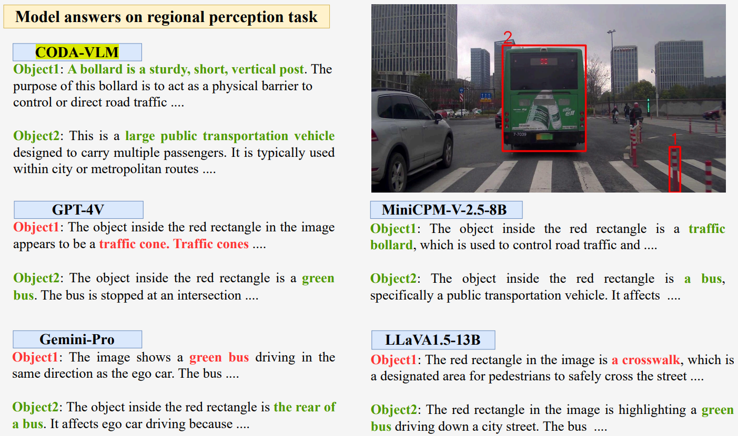
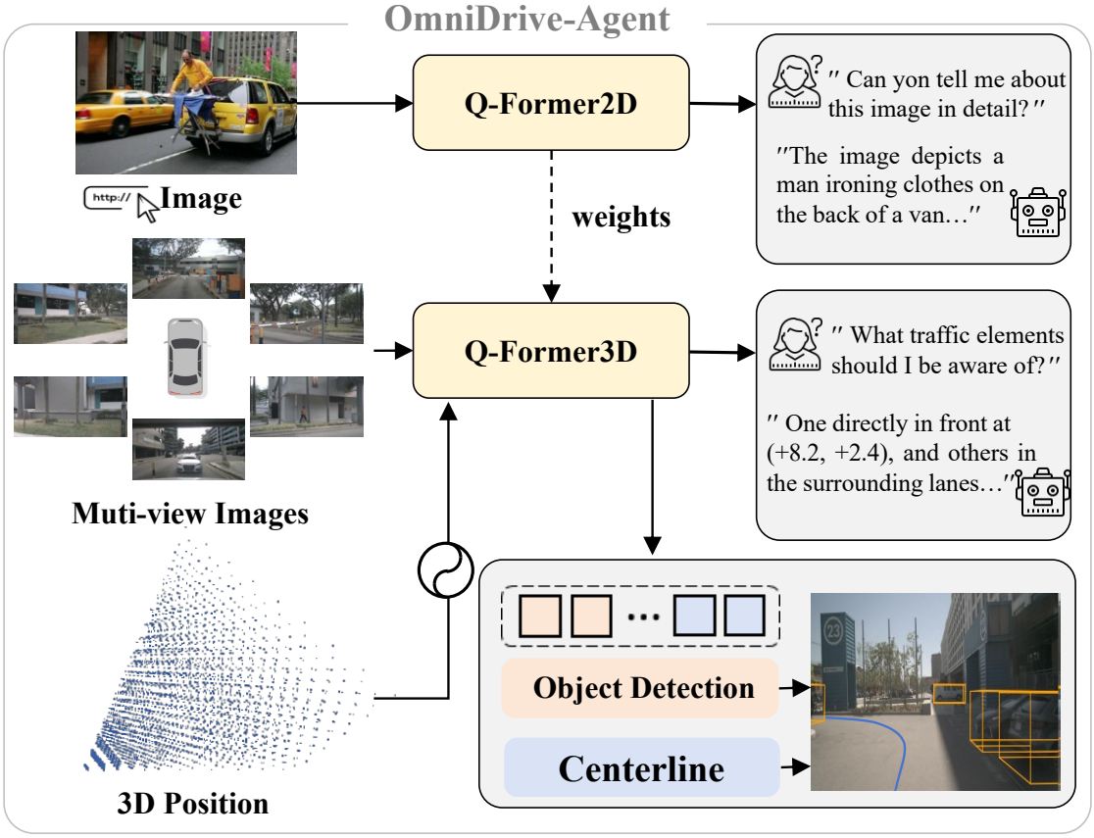
Automated Evaluation of Large Vision-Language Models on Self-driving Corner Cases. Chen et al., arXiv 2024.
OmniDrive: A Holistic LLM-Agent Framework for Autonomous Driving with 3D Perception, Reasoning and Planning. Wang et al., arXiv 2024.
1. VLM as Scene Descriptor
Adapting general-purpose VLMs into the driving domain
VLM (LLaVA-Llama-3-8B) fine-tuned on the CODA-LM dataset gets better perception results.
OmniDrive takes multi-view images and 3D point clouds as inputs, accomplishing perception and reasoning QAs.
Notes:
*First one. Given the success of the large-language model, a lot of researchers hope to bring it to driving scenarios, they carefully designed question prompts and get answers in text-format.
*In order to improve the answering quality, it is usually necessary to perform fine-tuning with driving data.
*For example, vision-language model fine-tuned on the CODA-LM dataset gets better perception results for corner cases, which reveals the importance of alignment training.
*Further more, OmniDrive extends the model input from a single front-view image to multiple views as well as LiDAR point clouds.

Slide 8
1. VLM as Scene Descriptor: Challenges
VLM inputs get more complex, raises more challenges on alignment.
front-view single image -> multi-view images/videos -> multi-sensor inputs -> …
How to empower the autonomous vehicles ?
requiring a larger VLM and lots of input & output tokens, thus usually runs on the cloud
usually back to the traditional paradigm: collect -> annotate with vlm -> re-train
Challenges:
high-resolutional perception: traffic lights, traffic signs, small obstacles, etc.
long-term memory: modeling long-term driving videos.
multi-sensor alignment: effectively tokenizing multi-modal inputs.
lack of aligned text label: language-labeled data in driving scenarios.
Notes:
*As the inputs of vision-language model get more and more complex, from…to, then…; It naturally raises more challenges on the alignment training. I only present part of them.
No.1, perception for small objects is often difficult for VLMs, it requires improving the ability of high-resolutional perception.
No.2, long-term memory is usually required for some complex decision-making scenarios.
No.3, it requires more effective tokenizing strategy to align text-knowledge with multi-modal inputs.
No.4, the alignment training requires lots of language-labeled data, but it’s usually insufficient in driving scenarios.
*Another question is, even if we get a properly aligned scene descriptor, how to empower the autonomous vehicles with it.
Since it usually requires a larger vision-language model and lots of input & output tokens, the most potential application is for data annotation on the cloud. It still belong to the traditional paradigm for solving corner cases.

Slide 9
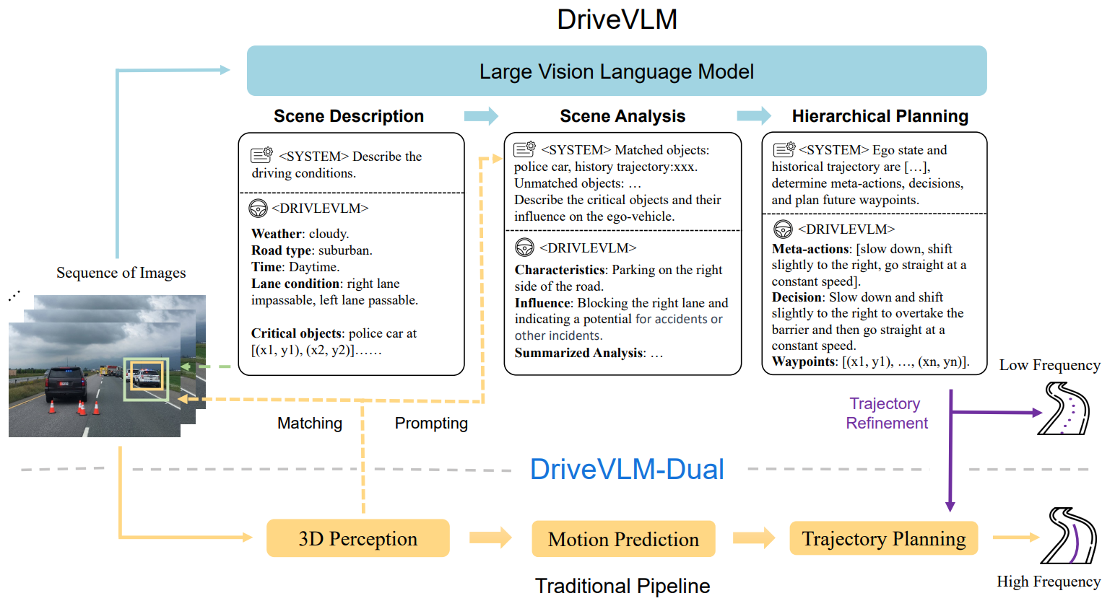
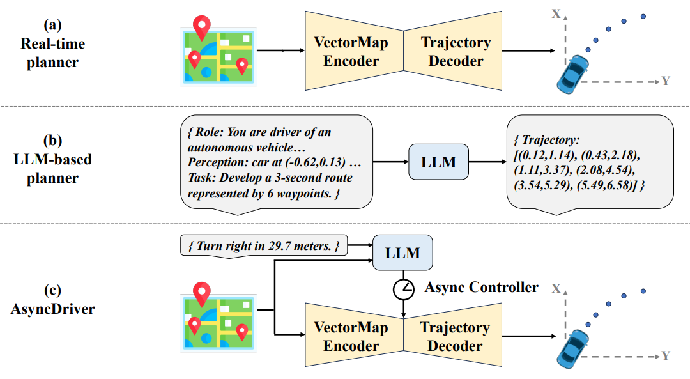
DriveVLM: The Convergence of Autonomous Driving and Large Vision-Language Models. Tian et al., CoRL 2024.
Asynchronous Large Language Model Enhanced Planner for Autonomous Driving. Chen et al., ECCV 2024.
2. VLM co-work with Planner
Decoupling the inference frequencies of VLM (slow) and planner (fast)
LLM and the real-time planner
Branch 1: 3D perception and trajectory planning in real-time
Branch 2: VLM produces better decision and trajectory at low frequency with chain-of-thought reasoning
Branch 1: a real-time trajectory planner
Branch 2: LLM provides high-level instruction features with an asynchronous controller
Notes:
*Second one. The motivation behind vision-language model co-working with planner is to decouple the inference frequencies of the two models. For example,
*DriveVLM proposed a dual branch driving system, where the fast branch performs 3D perception and trajectory planning in real-time, and another slow branch adopts vision-language model for better decision-making and trajectory planning with chain-of-thought reasoning. Results of two models are fused asynchronously.
*Besides, another work name AsyncDriver adopts the similar idea, which a large language model provides high-level instruction features, and these features are fused with an asynchronous controller.

Slide 10
2. VLM co-work with Planner: Challenges
VLM runs at low frequency, but still suffers from the limited in-vehicle computing.
Solving harder cases relies on complex reasoning, thus requires more test-time computation (like OpenAI o1).
Complex chain-of-thought reasoning requires a large number of tokens, or multi-round inference.
Unable to handle some suddenly appeared rare events.
Co-optimizing VLM with existing e2e/planning models is not easy.
Training together involves more learning and engineering difficulties.
Training individually (e.g., passing perception/reasoning results instead of features) needs additional parsing process and limits the ability of VLM (i.e., focus on limited cases only).
It is hard to resolve the conflicts between the two systems (e.g., totally different decisions).
The well-known hallucination problem.
Notes:
*In this context, the vision-language model runs at low frequency, but still suffers from the limited in-vehicle computing.
More specifically, solving harder cases relies on complex reasoning, thus requires more test-time computation, just like the recent released o1, which achieves better reasoning with more test-time computation.
Complex chain-of-thought reasoning requires a large number of tokens, or multi-round inference.
In addition, these model may failed to handle some suddenly appeared rare events.
*Another question, co-optimization of the two models is not an easy work to do.
Training them together involves more learning and engineering difficulties.
But training them individually (like passing perception or reasoning results instead of the features) needs additional process and may limit the ability of vision-language models.
Besides, when the two models have conflicts in prediction, such as totally different decisions, it will be hard to resolve the conflicts.
It’s unreliable to totally trust the vision-language model because of the hallucination problem.

Slide 11
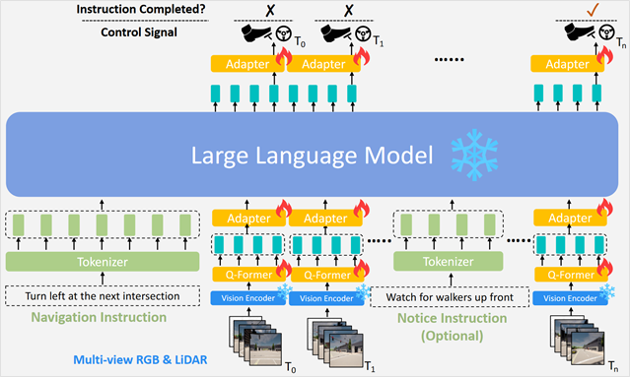
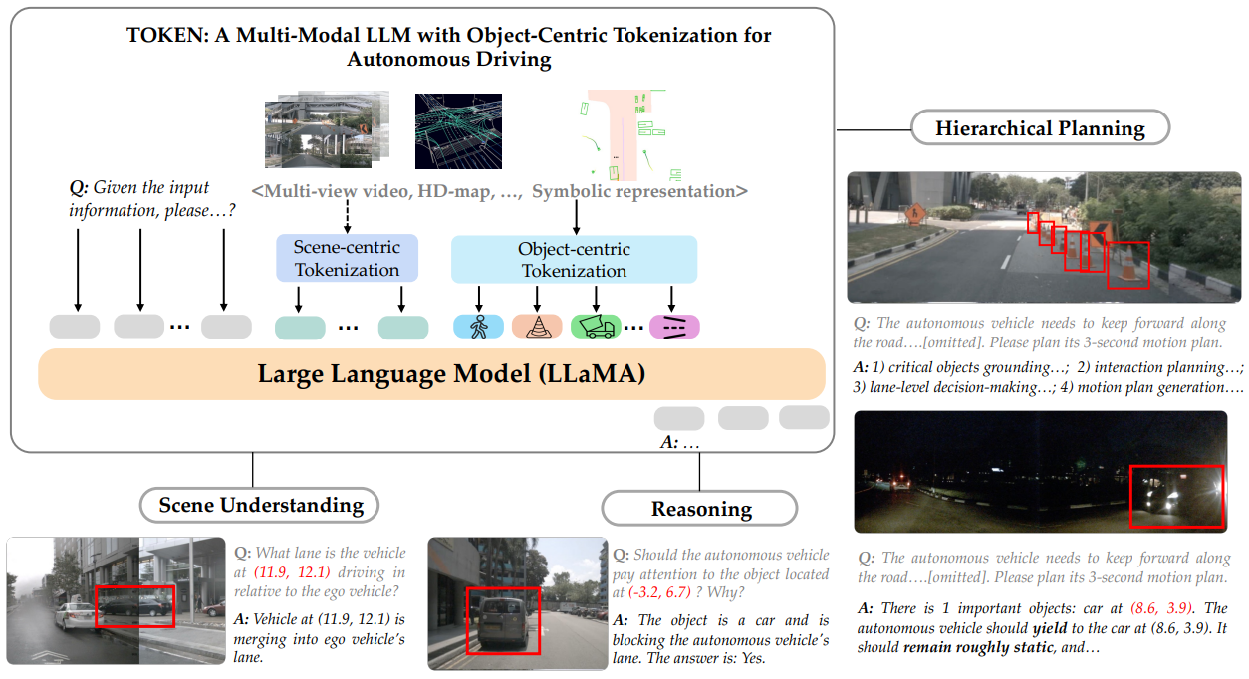
LMDrive: Closed-Loop End-to-End Driving with Large Language Models. Shao et al., CVPR 2024.
Tokenize the World into Object-level Knowledge to Address Long-tail Events in Autonomous Driving. Tian et al., arXiv 2024.
3. VLM for E2E Driving
VLM takes multi-sensor inputs, and predicts action or trajectory of ego-vehicle.
Tokenizing visual inputs with a BEV model.
Decoding actions from the last token with a MLP.
Close-loop testing on the CARLA simulator.
Scene/object-centric tokenization of multi-modal inputs.
Predicting ego-trajectory in texts with CoT reasoning.
Better planning results on long-tail scenarios.
Notes:
*Third one. Vision-language model for end-to-end driving, where the vision-language model takes multi-sensor inputs and directly predicting action or trajectory of ego-vehicles. For example,
*LMDrive tokenized the visual inputs with a BEV encoder, and decoding the ego action from the last output token with an extra MLP decoder.
*Another work proposes the scene and object-centric tokenization to process multi-modal inputs.
It predicts ego-trajectory in text-format with chain-of-thought reasoning.
As a result, it achieves better trajectory planning results on long-tail scenarios.

Slide 12
3. VLM for E2E Driving: Challenges
Vision-language-action (V-L-A) alignment raises new challenges.
Critical shortages of language-labeled training data in driving scenarios.
Model suffers from the limited in-vehicle computing, more seriously.
Requiring real-time inference for end-to-end driving.
Severely limiting the model size and autoregressive tokens.
How to decode the action or trajectory of ego-vehicle ?
Modeling trajectories as texts involves a large number of output tokens. Besides, VLMs are usually not good at numeric calculation. The predicted trajectory may be unreliable due to hallucination.
Applying an extra decoder reduces the number of output tokens, but raises new challenges to the learned representation of tokens.
Notes:
*For this case, we are essentially doing the vision-language-action alignment, which is much more challenging.
One critical problem is the shortage of language-labeled training data in driving scenarios.
*Again, the issue of computational cost, becomes more serious in this case.
The requirement of real-time inference severely limits the model size and the number of autoregressive tokens.
*And there is another problem: how to decode the action or trajectory of ego-vehicle.
The two methods just introduced use different ways to decode, and they each have their drawbacks.
On the one hand, modeling trajectory as text involves a large number of output tokens. As we all know, large-language models are usually not good at numeric calculation. The predicted trajectory may be unreliable due to hallucination.
On the other hand, applying an extra decoder successfully reduces the number of output tokens, but raises new challenges to the learned representation of the tokens.
How to model trajectories in a language model is still an unsolved problem.

Slide 13
From Driving VLMs to Driving World Models
Driving
Vision-Language Model
Knowledge mostly comes from the pre-training text corpus. Alignment for driving scenario is not easy.
Driving World Model
Building driving-native foundation models.
World model as driving simulator
World model for e2e driving
Notes:
*Solving corner cases with vision-language model is a promising approach, but there are some inherent challenges.
In these methods, knowledge mostly comes from the pre-training text corpus. Alignment for driving scenario is not easy.
*Therefore, another ambitious goal is to build the driving-native foundation models, called the Driving World Model.
The previous speakers have also touched on this topic.
This direction is still rather preliminary, and we roughly divide it into two topics, world model as driving simulator, and world model for end-to-end driving.

Slide 14
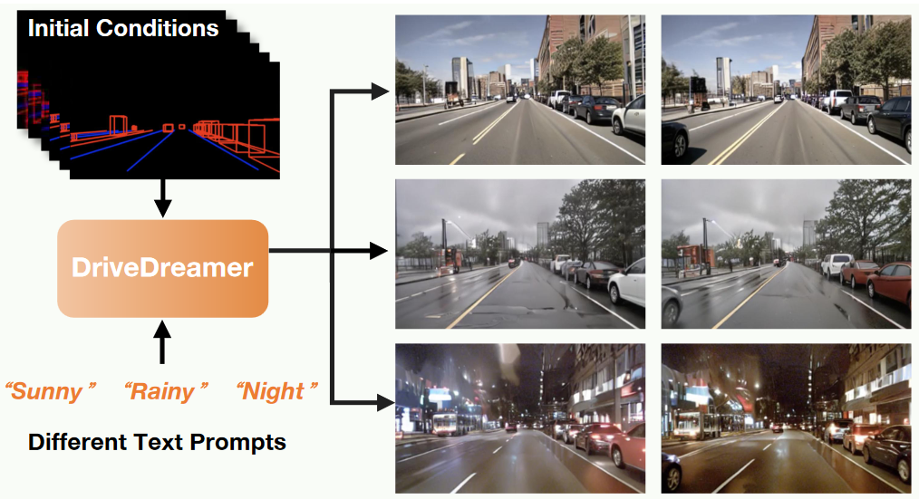
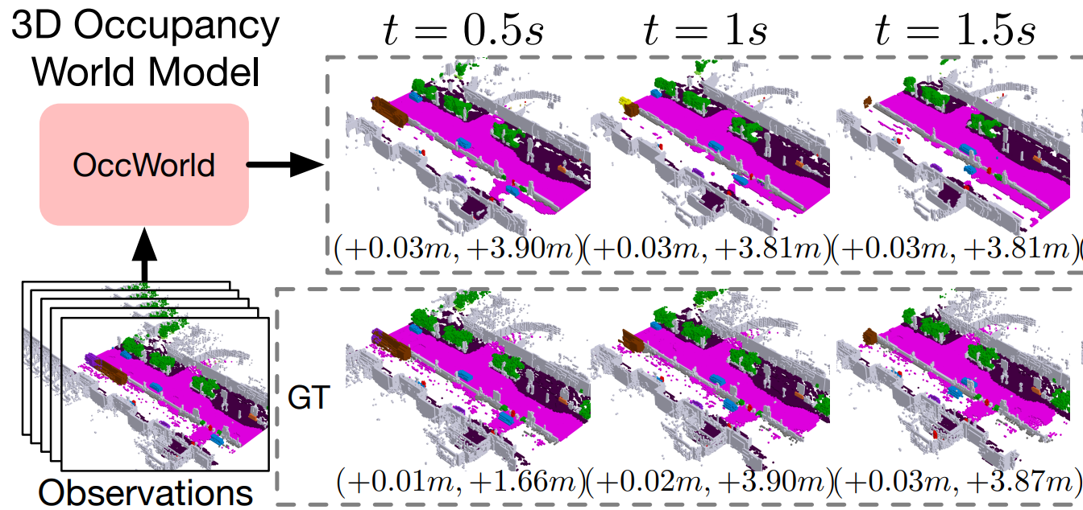
DriveDreamer: Towards Real-world-driven World Models for Autonomous Driving, Wang et al., ECCV 2024.
OccWorld: Learning a 3D Occupancy World Model for Autonomous Driving, Zheng et al., ECCV 2024
1. World Model as Driving Simulator
Generating 2D or 3D future scenes with world models
Controllable driving video generation, conditioned on text prompts and structured traffic constraints.
3D occupancy forecasting, given the past 3D occupancy observations.
Usage: 1) generation of novel views, 2) generation of corner cases.
Notes:
*The application of generative models, such as diffusion model to do video generation for driving scenes is a direction that has received a lot of attention in the past year.
The key behind these method is to generate 2d or 3d future scenes with world models.
*The main usage includes the generation of novel views, and the generation of corner cases.
A notable trend is that the generated content is becoming richer and richer, ranging from 2d to 3d, and so on.

Slide 15
1. World Model as Driving Simulator: Challenges
High-quality controllable generation is challenging.
Spatial-temporal consistency.
Following of the given instruction and physical rules.
Reducing the computational costs of generation is demanded.
Excessive computational cost makes the neural simulator impractical.
Notes:
However, high-quality controllable generation is still challenging.
It requires the spatial-temporal consistency, and the following of the given instruction and physical rules.
Another problem is the generation cost, excessive computational cost makes the neural simulator impractical.

Slide 16
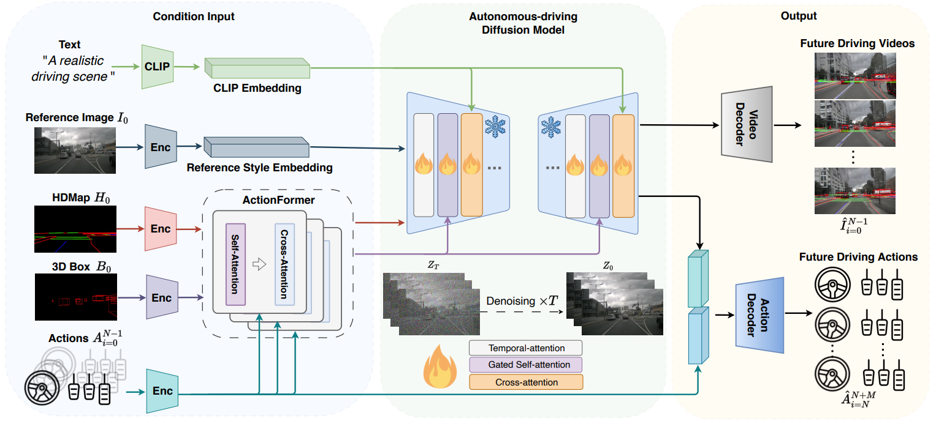
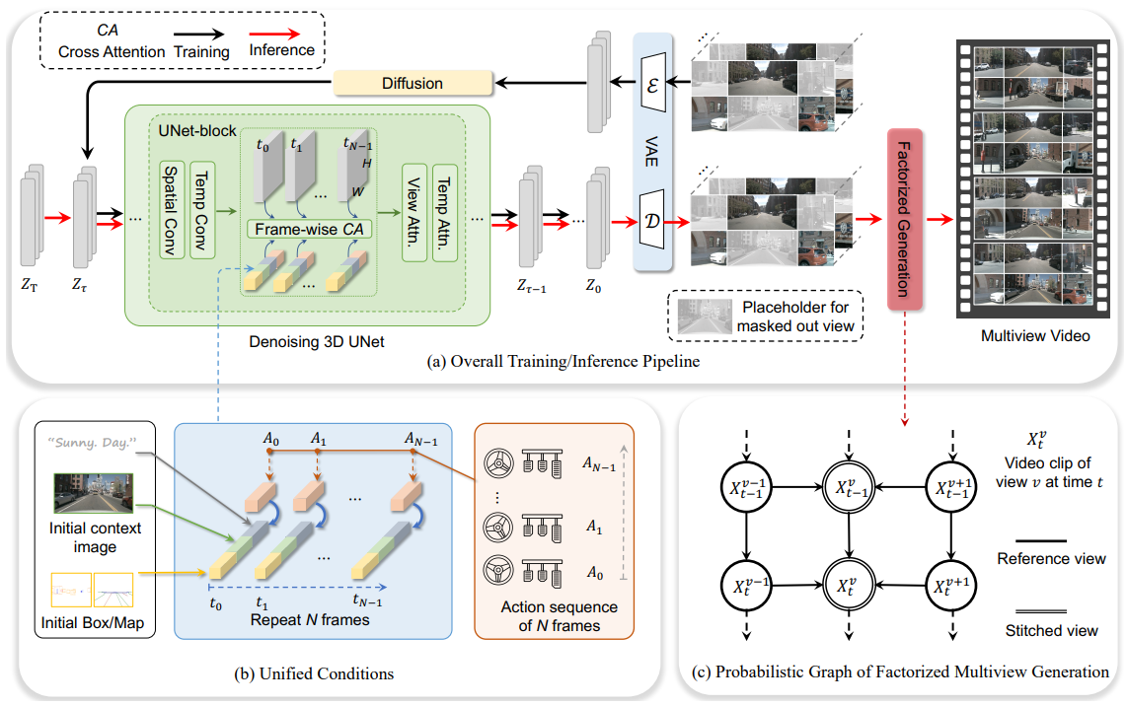
DriveDreamer: Towards Real-world-driven World Models for Autonomous Driving. Wang et al., ECCV 2024.
Driving into the Future: Multiview Visual Forecasting and Planning with World Model … Wang et al., CVPR 2024
2. World Model for E2E Driving
World model takes multi-sensor inputs, and generates future actions of ego-vehicle.
DriveDreamer generates driving video conditioned on text prompts and structured traffic constraint, and predicts future actions.
Drive-WM generates high-fidelity multi-view driving videos and predicts future actions.
Notes:
*Another direction is world model for end-to-end driving, but it's still in the very preliminary stages.
Some approaches have explored predicting future actions while generating future frames.
*We think the logic behind this is reasonable. The features needed to generate accurate future frames may contain rich geometry and semantics that could potentially be used for action prediction.

Slide 17
2. World Model for E2E Driving: Challenges
Mostly focused on controllable driving video generation, with an extra action head.
The inference cost is far beyond the limits of the in-vehicle computing platform.
We call for world models as the next-generation e2e driver.
A good world model representation is potential to make better planning. (implicitly: past frame status -> next frame status -> future planning)
It is not necessarily to reconstruct accurate future videos for e2e driving.
Notes:
*As I just said, this direction is still in a very preliminary stage and is still a long way from real-time end-to-end driving.
But we call for world models as the next-generation architecture of end-to-end driving.
*The logic behind this is: a good world model representation is potential to make better planning, but it’s not necessarily to reconstruct accurate future frames for end-to-end driving.
*To realize this goal, it’s crucial to have properly defined intermediate states and the corresponded state transition algorithms.

Slide 18
Summary
Foundation models provide new ways to solve corner cases for autonomous driving, but it is still challenging to make them work in practice.
Driving
Vision-Language Model
VLM as Scene Descriptor
VLM co-work with Planner
VLM for E2E Driving
World Model as Driving Simulator
World Model for E2E Driving
…
Driving World Model
Notes:
*For a brief summary of what we have discussed today, foundation models provide new ways to solve corner cases for autonomous driving, but it is still challenging to make them work in practice.
*It is hoped to discuss and collaborate with the community of computer vision to solve these challenges.

Slide 19
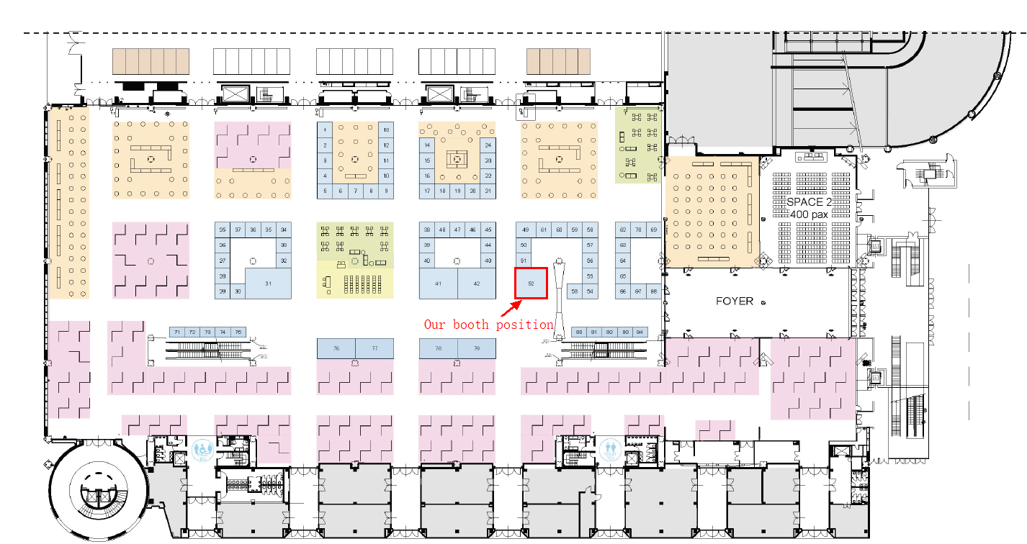
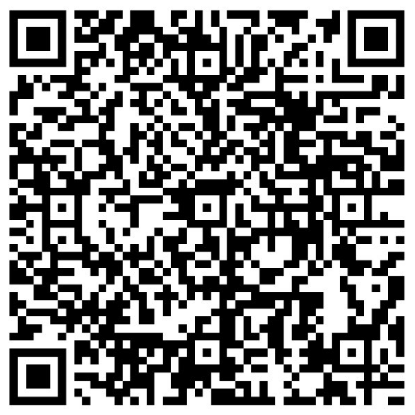

Contacts: tangchufeng1@huawei.com
Meets Huawei at ECCV
Booth Number: Mico South - Level 0 - Stand 52
Recruitment Wechat Group
https://career.huawei.com/
Notes:
*And lastly, Huawei is a gold sponsor of ECCV this year.
We have set up a booth at Stand-52 of level-0.
You are most welcome to visit us at our booth, we will be showcasing our latest innovations in the field of computer vision, discussing challenges, and exploring potential collaborations.
*Additionally, we are looking for talented individuals who are passionate about pushing the boundaries of computer vision and autonomous driving. If you or anyone you know might be interested in joining us, please feel free to drop by our booth for more information or visit our career pages.

Slide 20
Notes:
That's all I'm sharing today.
Thanks for your attention.

